Slide 1
SPACEX FALCON 9 LAUNCH ANALYSIS
Nousheen Ali
05 – OCT - 2021

Slide 2
CONTENTS
Executive Summary
Introduction
Methodology
Results
Conclusion

Slide 3


EXECUTIVE SUMMARY
METHODOLGY
Initially data was collected using REST API, Web scraping.
The raw data was cleaned to obtain structured data through Data Wrangling.
To obtain insights from the data, Exploratory Data Analysis was performed using SQL queries and Visualizations using graphs and charts.
Interactive visual Analysis was performed using Folium Maps and Plotly Dashboard.
Predictive Analysis was done to determine best Machine Learning Model.
Exploratory Data Analysis Results.
Interactive Visual Analysis Results.
Predictive Analysis Results.
RESULTS

Slide 4
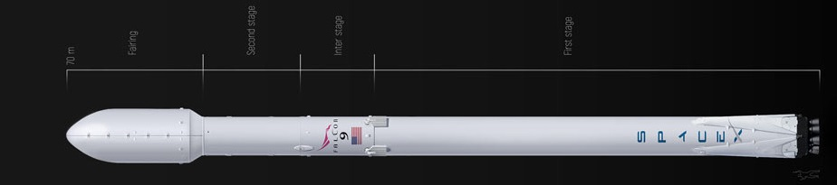
INTRODUCTION
Space travel has always been a dream for the human race. In the last decade, however, this dream is turning to a reality with the help of companies such as SpaceX, Blue Origin and Virgin Galactic.
SpaceX has been the most successful in this field. SpaceX advertises Falcon 9 rocket launches on its website, with a cost of 62 million dollars where other providers cost upward of 165 million dollars each. SpaceX Falcon 9 are able to provide relatively cheaper rates because it can recover the first stage of the rocket unlike its peers. The first stage of the rocket does most of the work and is much larger and expensive than the second stage.

Slide 5
UNDERSTANDING THE PROBLEM
Which features affect the outcome of a launch?
Which Machine Learning Model gives the highest accuracy in predicting the success of future launches?

Slide 6
METHODOLOGY

Slide 7

DATA COLLECTION
Data collection using SpaceX API
Representational State Transfer Application Program Interface (REST API/ simply API) refers to a set of protocols that a user can use to query a web service for data.
Make a REST API CALL to SpaceX Website
Response received in JSON Format
JSON response Normalized
Handle NULL values
Create DataFrame and filter it to contain info on Falcon9
Retrieve additional info such as BoosterVersion,
PayloadMass,
Orbit, LaunchSite etc.
https://github.com/nousheenali/Coursera_Capstone/blob/master/Data%20Collection%20API.ipynb

Slide 8
Data collection using Web Scraping
This is the process of extracting Data from a webpage. Once data is scarped it is exported into a more convenient format.
Make a request to SpaceX Falcon 9 launches Wikipage
Create a BeautifulSoup object from the Response
Find the table using BeautifulSoup find_all function
(output format: html)
Create a DataFrame from the launch_dict
Create a dictionary `launch_dict` for extracted table rows
Iterate the output to find <th> elements and extract column header
https://github.com/nousheenali/Coursera_Capstone/blob/master/Data%20Collection%20and%20Web%20Scraping.ipynb

Slide 9
DATA WRANGLING
The process of cleaning, structuring and enriching raw data into a desired format for better decision making in less time.
The DataFrame is checked for NULL values
Identify the columns that are Numerical and Categorical
A new column ‘Class’ created to store landing outcomes
0 – Failure
1 - Success
Calculate no. of occurrences of each Launch site, Orbit and landing outcome in the dataset using value_counts()
https://github.com/nousheenali/Coursera_Capstone/blob/master/Data%20Wrangling.ipynb

Slide 10
EXPLORATORY DATA ANALYSIS (EDA)
Exploratory Data Analysis refers to the critical process of performing initial investigations on data so as to discover patterns, to spot anomalies, to test hypothesis and to check assumptions with the help of summary statistics and graphical representations.

Slide 11

EDA with VISUALIZATION
Scatter Plot is used to find how the relation between two features will affect a certain outcome. The following relations were explored using scatter plot, to find its effect on the Launch Outcome(Class):
Flight Number vs Launch Site
Payload Mass vs Launch Site
Flight Number vs Orbit
Payload Mass vs Orbit

Slide 12


EDA with VISUALIZATION
A Bar chart performs a comparison of values across different subgroups of your data. In our case the bar graph
was plotted to observe Orbit Type vs Success Rate
A line plot is a graph that shows frequency of data along a number line. Here we used it show the Average Success Rate vs Years
https://github.com/nousheenali/Coursera_Capstone/blob/master/EDA%20with%20Data%20Visualization.ipynb

Slide 13

EDA with SQL
Data made available in .csv format is stored in a SQL table then exploratory analysis was performed and the following information was obtained using SQL queries.
Unique launch site names.
Launch sites begin with 'CCA’ (5 records)
Total payload mass carried by boosters launched by NASA (CRS)
Average payload mass carried by booster version F9 v1.1.
Date of first successful landing outcome in ground pad.
Names of the boosters which have success in drone ship (with 4000 < payload mass < 6000)
Total number of successful and failure mission outcomes
Names of the booster_versions that carried the maximum payload mass.
Failed landing_outcomes in drone ship, their booster versions, and launch site names for in year 2015
Rank the count of landing outcomes (such as Failure (drone ship) or Success (ground pad)) between the date 2010-06-04 and 2017-03-20, in descending order¶
https://github.com/nousheenali/Coursera_Capstone/blob/master/EDA%20with%20SQL.ipynb

Slide 14
Interactive Visual Analytics
Interactive Visual Analytics enables visualization, interaction, and automatic computation to facilitate insight generation from data.
It presents data in such a manner that it is more understandable and appealing and helps to filter data in real time.
To create a dashboard, we have used
Folium
Plotly Dash

Slide 15
Folium Map
We have used the Folium to
Mark all Launch sites with the coordinates information from the dataset.
Mark successful(green) and failed(red) launches on each site.
Calculate and display distance between a particular launch site and a nearby location, with a polyline connecting both sites.
https://github.com/nousheenali/Coursera_Capstone/blob/master/Interactive%20Visual%20Analytics%20with%20Folium%20lab.ipynb
Plotly Dash
Features included in the dashboard are:
A Launch Site dropdown input component
A pie chart that displays success rate based on the dropdown selection.
A range slider to select payload mass.
The scatter plot to show correlation between success rate and payload mass based on selection made on the slider and dropdown.
https://github.com/nousheenali/Coursera_Capstone/blob/master/spacex_dash_app.py

Slide 16
Predictive Analysis
Predictive Analysis makes predictions about future outcomes using historical data combined with statistical modeling and machine learning techniques.
Our assignment here is to build a model to predict if SpaceX Falcon 9 will land successfully or not.
The steps involve:
Preprocessing: Create X and Y containing the input set and the output respectively. Standardize the X dataset.
Train Test Split : Split X and Y to train and subsequently test the model.
Model used : Logistic Regression, Support Vector Machine(SVM), Decision Tree Classifier, K Nearest Neighbour(KNN)
For each of the models, we train the model and perform Gridsearch to find hyperparameters that helps the algorithm perform its best
With the best hyperparameter values we find apt model with best accuracy using test data.

Slide 17
Developing a Machine Learning Model
Create a GridSearch object for the model with a set of parameters
Fit the model with the train data.
Create a object of the machine learning model
Plot confusion matrix for further analysis.
Test the model using test data to obtain accuracy.
Obtain the best parameters and accuracy from the trained model
https://github.com/nousheenali/Coursera_Capstone/blob/master/Machine%20Learning%20Prediction.ipynb

Slide 18
RESULTS

Slide 19
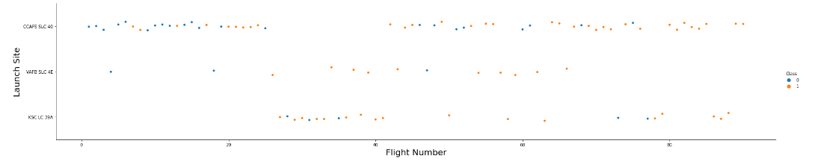
EXPLORARY DATA ANALYSIS – Using Visualization
Refer slides 11 and 12
Flight Number vs Launch Site
As flight number increases , more successful launches occur for each site.

Slide 20
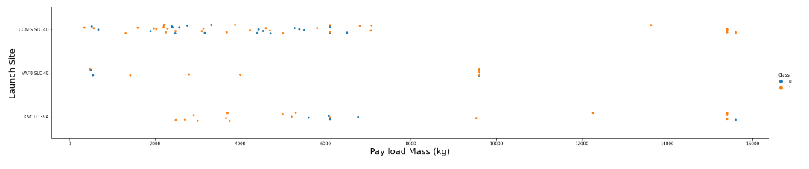
Flight Number vs Payload Mass
As Payload Mass increases more success rate is higher for all 3 sites.
For the site KSC LC 39A, success rate was high at for payload mass < 5000Kg

Slide 21
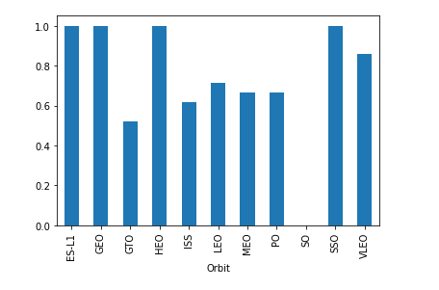
Orbit vs Success Rate
GEO, HEO, SSO,ES-L1 orbits have 100% success rate
GTO orbit has the lowest success rate of 50 %

Slide 22
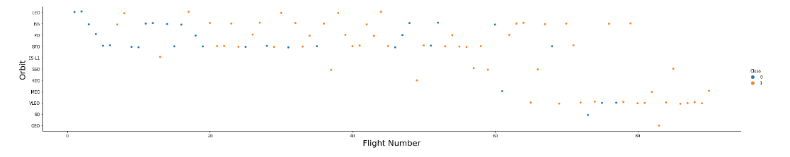
Flight Number vs Orbit
There doesn’t seem to be correlation between flight number and orbit.

Slide 23
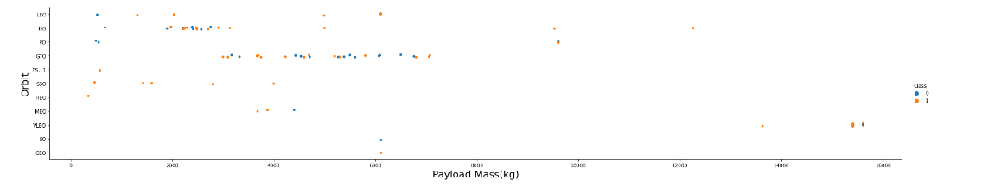
Payload Mass vs Orbit
Payload Mass has different impacts on different orbits.

Slide 24
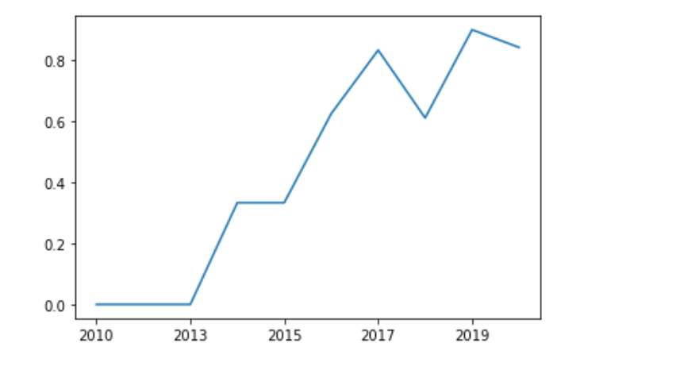
Average Success Rate vs Years
It is observed that the success rate since 2013 kept increasing till 2017. It showed a drop in year 2018 only to increase by 2019.

Slide 25
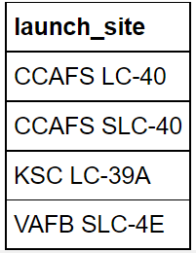
EXPLORARY DATA ANALYSIS – Using SQL
Refer slides 13
1. Unique Launch Sites
Result:

Slide 26
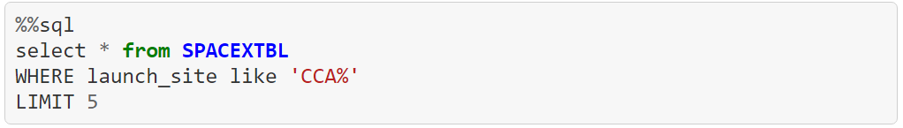
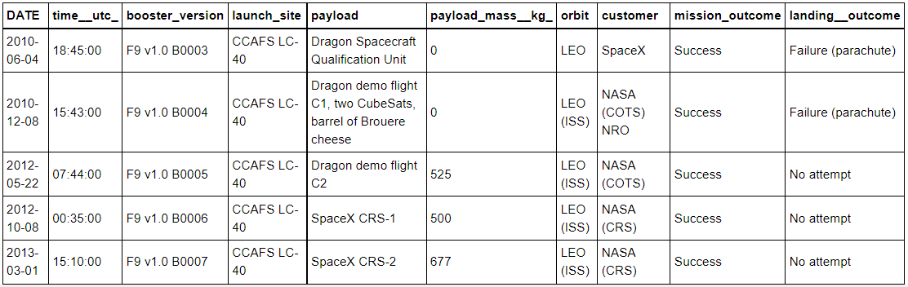
2. Launch site names begin with `CCA`
Result:

Slide 27
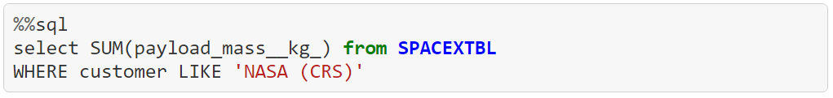

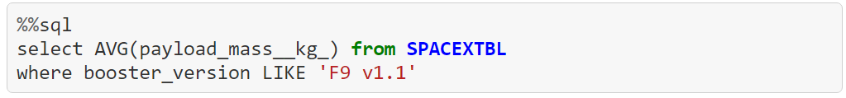

3. Total payload mass carried by boosters launched by NASA (CRS)
Result:
4. Average payload mass carried by booster version F9 v1.1
Result:

Slide 28

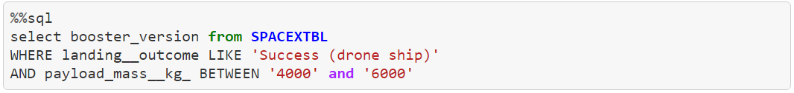
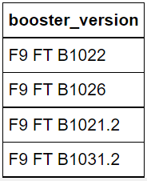
5. Date of first successful landing outcome in ground pad.
Result:
6. Names of the boosters which have success in drone ship (with 4000 < payload mass < 6000)
Result:

Slide 29


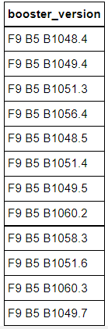
7. Total number of successful and failure mission outcomes
Result:
8. Names of the booster_versions that carried the maximum payload mass
Result:

Slide 30


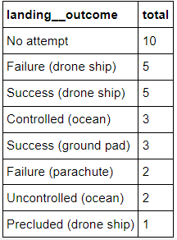

9. Failed landing_outcomes in drone ship, their booster versions, and launch site names for in year 2015
Result:
10. Rank the count of landing outcomes (such as Failure (drone ship) or Success (ground pad)) between the date 2010-06-04 and 2017-03-20, in descending order
Result:

Slide 31
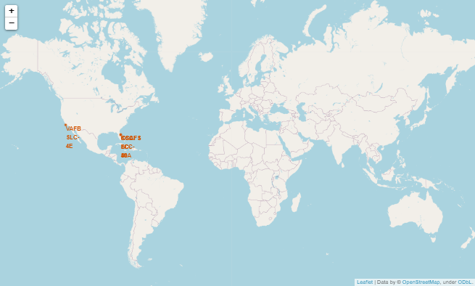
Interactive Visual Analytics – Folium Map
Refer slides 14 and 15
The map indicates all the launch sites using Folium markers.
Observations:
Are all launch sites in proximity to the Equator line?
They appear closer o the Tropic of cancer.
Are all launch sites in very close proximity to the coast?
Yes, all the sites are closer to the coast

Slide 32
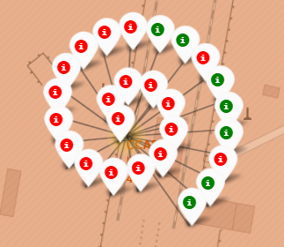
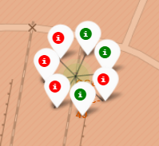
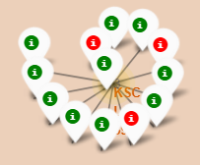
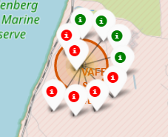
Successful and failed launches for each site
CCAFS LC-40
CCAFS SLC-40
KSC LC-39A
VAFB SLC-4E
Here the failed launches have been indicated using RED and successful ones are indicated using GREEN. The color-labeled markers in marker clusters help easily identify which launch sites have relatively high success rates.

Slide 33
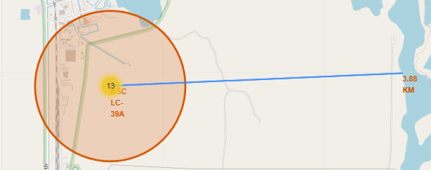
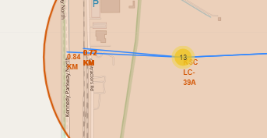
Distance Between a Launch Site and it’s Proximities
Distance from the site KSC LC-39A to a location on coastline : 3.88 KM
Distance from the site KSC LC-39A to the nearest railway : 0.72 KM
Distance from the site KSC LC-39A to the nearest highway: 0.84 KM

Slide 34
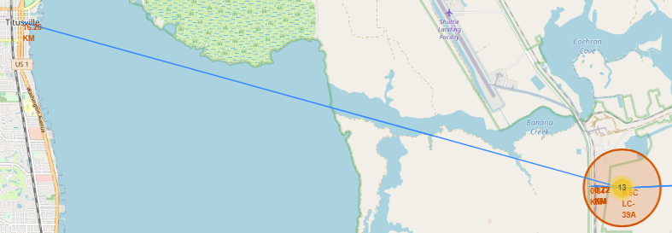
Distance from the site KSC LC-39A to the nearest city(Titusville): 16.28 KM
Observations
Are launch sites in close proximity to railways?
Yes, the closest railway line to site KSC LC-39A is within a kilometer.
Are launch sites in close proximity to highways?
Yes, the closest highway line to site KSC LC-39A is within a kilometer.
Are launch sites in close proximity to coastline?
Yes, all the launch sites are near the coastline.
Do launch sites keep certain distance away from cities?
Yes, all cities are at a considerable distance from the launch sites. Eg: Closest city (Titusville) is 16.28 KM away from the launch site KSC LC-39A.

Slide 35
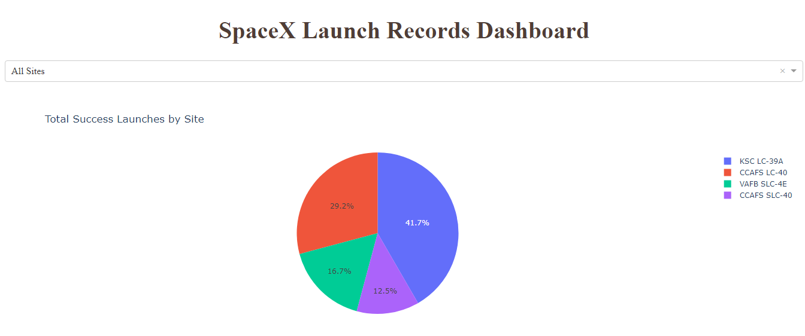
Interactive Visual Analytics – Plotly Dash
Refer slides 14 and 15
The site KSC LC-39A has the highest rate of success at 41.7%.
The site CCAFS SLC-40 has the lowest rate of success at 12.5%.

Slide 36
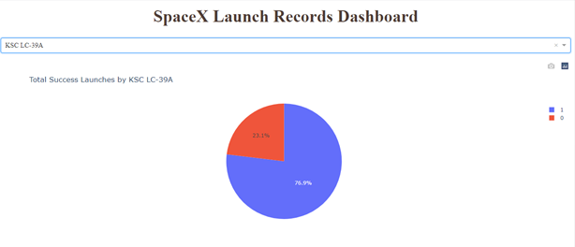
If any one site is selected, the pie chart displays the percentage of successes and failures.
The launch site with highest success ratio KSC LC-39A, has had 76.9% successful launches and 23.1% failures.

Slide 37
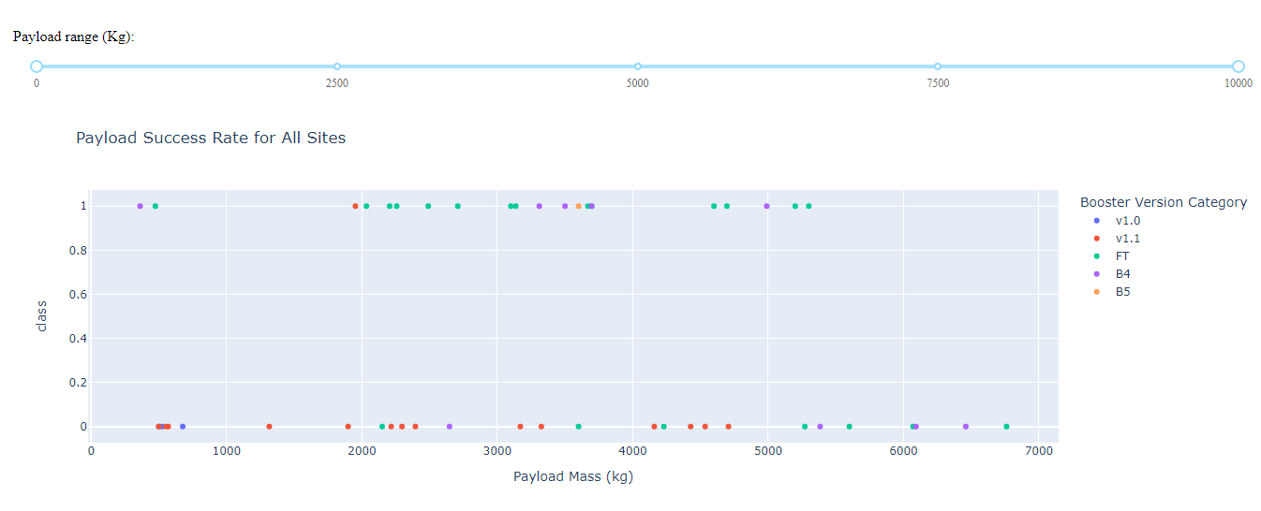
Payload Mass vs Class(success rate) scatter plot
Beyond the payload mass of 5500kg, the launches have been failures. Booster versions FT and B4 have had the more successful launches below this range.
Booster version V1.1 has mostly ended up in failure irrespective of the payload mass.

Slide 38
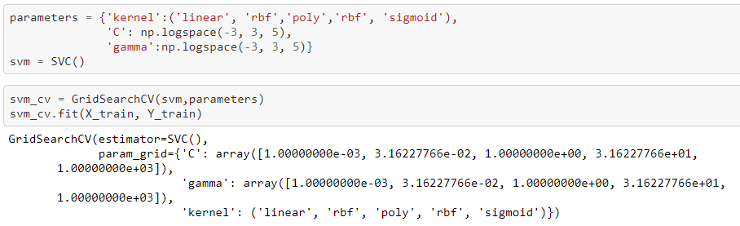


Predictive Analysis
Logistic Regression
Using training data on Gridsearch object we obtain the best parameters.
'C': 0.01’ 'penalty': ‘l2’ 'solver': 'lbfgs’
With the best parameters, logistic regression model gives an accuracy of 83.33% for test data.

Slide 39
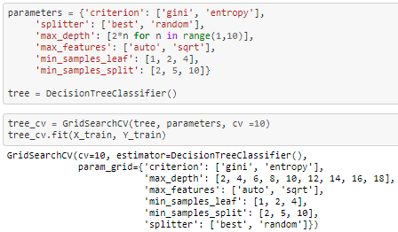
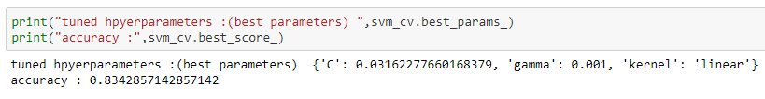

Support Vector Machine (SVM)
Using training data on Gridsearch object we obtain the best parameters.
'C': 0.03162277660168379
'gamma': 0.001
'kernel': 'linear’
With the best parameters, SVM model gives an accuracy of 83.33% for test data.

Slide 40
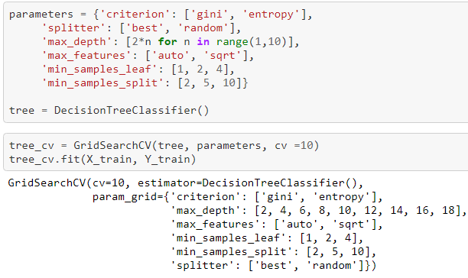
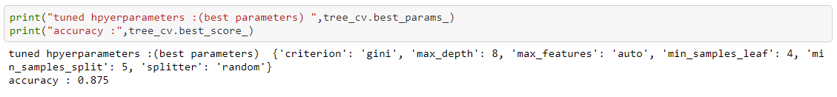

Decision Tree Classifier
Using training data on Gridsearch we obtain the best parameters.
'criterion': 'entropy’ 'max_depth’: 8
'max_features': ‘auto’ 'min_samples_leaf': 4 'min_samples_split’: 5 'splitter': ‘random’
With the best parameters, Decision Tree model gives an accuracy of 83.3% for test data.

Slide 41
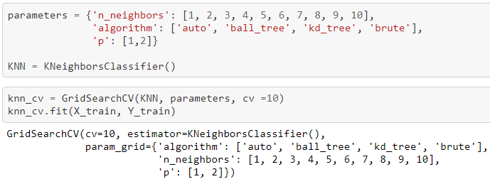
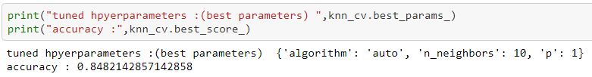

K Nearest Neighbor (KNN)
Using training data on Gridsearch we obtain the best parameters.
'algorithm': 'auto’
'n_neighbors': 10
'p’: 1
With the best parameters, KNN model gives an accuracy of 83.3% for test data.

Slide 42
Best Machine Learning Model
All the models perform equally well with an accuracy of 83.3% for test data.

Slide 43
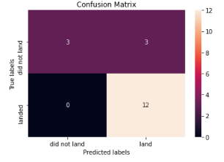
All the models have yielded the same results in the confusion matrix.
Examining the confusion matrix, we see that the model can distinguish between the different classes. We see that the major problem is false positives.

Slide 44

CONCLUSION
The features FlightNumber, PayloadMass, Orbit and LaunchSite influence the success/failure of the launch.
All launch sites are located near the coastline away from cities.
For booster versions, launches are more likely to be successful when payload mass is less than 6000kg.
All the machine learning models(Logistic regression, SVM, Decision Tree and KNN) are equally good as they all provide the same accuracy of 83.3%.

Slide 45

THANK YOU!

